Slide 1
Back to basics Sales management
with Belinda Amis Wheaton

Slide 2
Todays webinar
After todays webinar you may wish to re visit the webinar:
Back to basics - sales
A one hour training session designed to help create a strong sales management platform in your club, resulting in strong sales outcomes.

Slide 3
What is sales management?
The process that assists in ensuring sales targets are achieved consistently and effectively.
Are you up to the challenge?

Slide 4
Who is the sales manager in your club?
Who wears the sales managers hat?
Who is accountable?
One person? Two people?
Simplifying the amount of “sales manager” hats reduces mixed messages.
Does everyone in your club know who the sales manager is?

Slide 5
Ultimately, a sales manager is judged on sales outcomes!
If the team are performing, the sales manager is accountable.
If the team are not performing, the sales manager is accountable.

Slide 6
You CAN’T do everything your self.
Being a successful leader in this area, involves training your team to perform sales tasks as well or even better than yourself!!

Slide 7
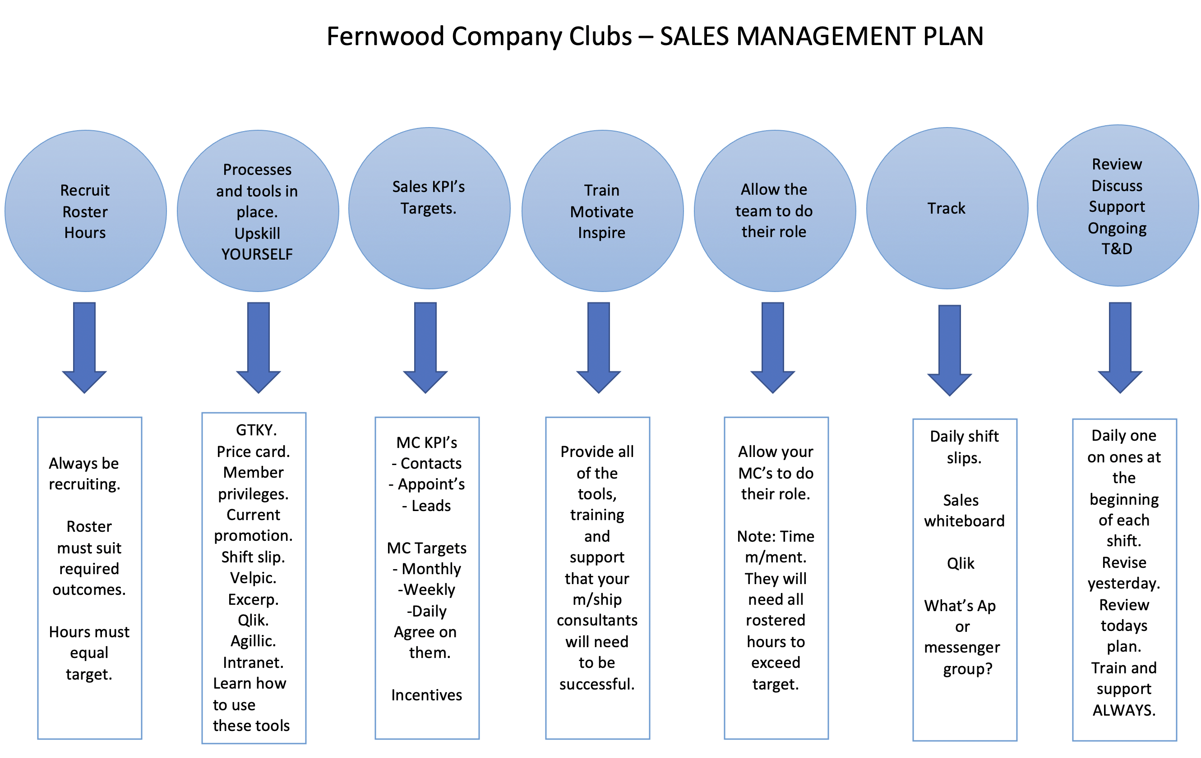
You’ll need a plan…

Slide 8
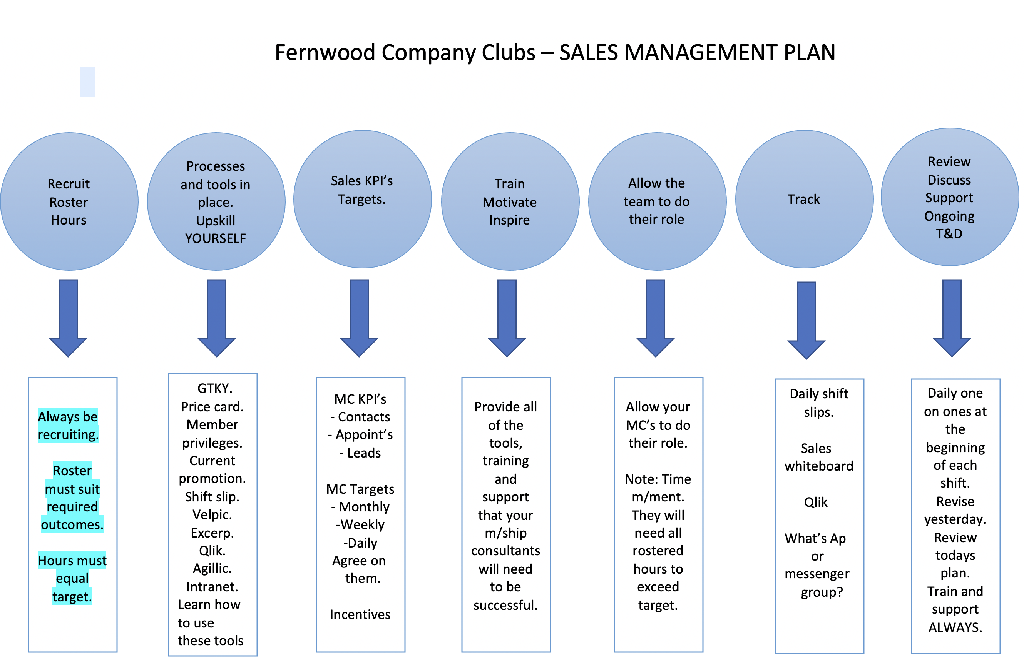
Sale management ball 1

Slide 9
Sales ball no. 1
Sales managers are always recruiting, EVEN when they have a full team.
If you were to lose a team member mid month, achieving target would more than likely be impacted unless you can replace the hours and skill quickly.

Slide 10
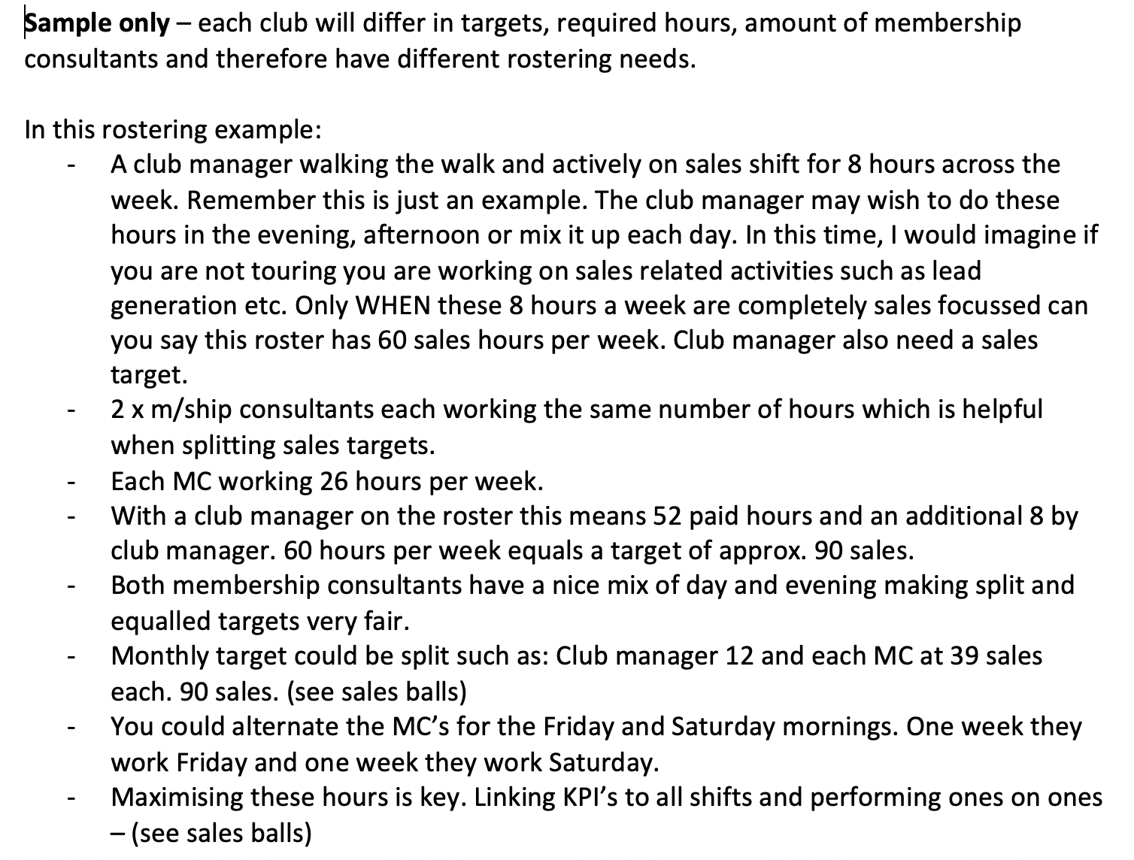
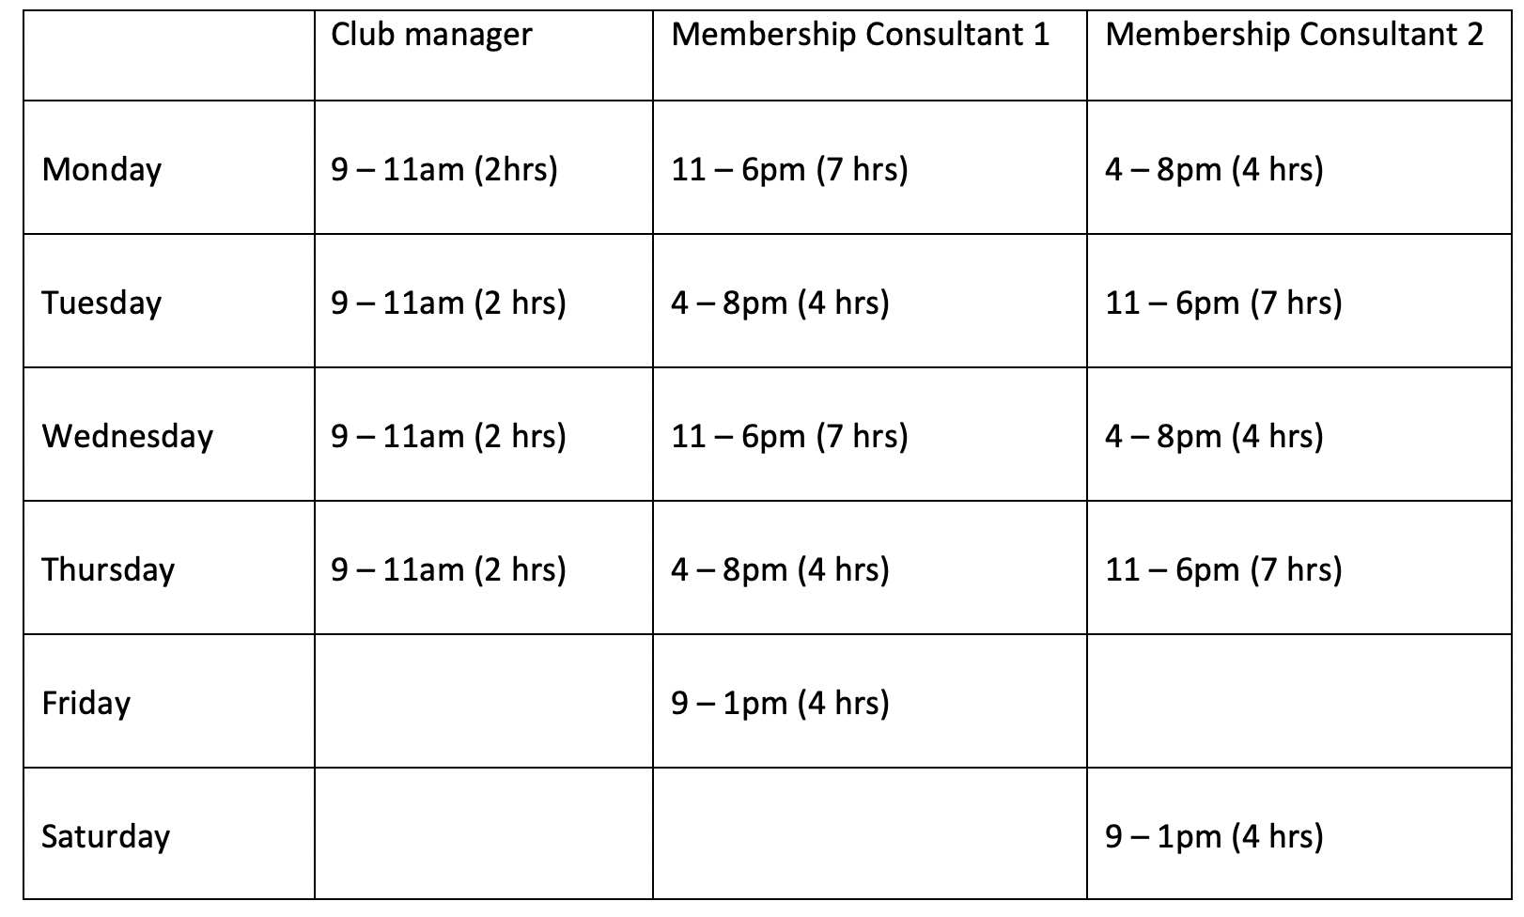
Sales ball no. 1 – roster to suit required outcome outcome (target)

Slide 11
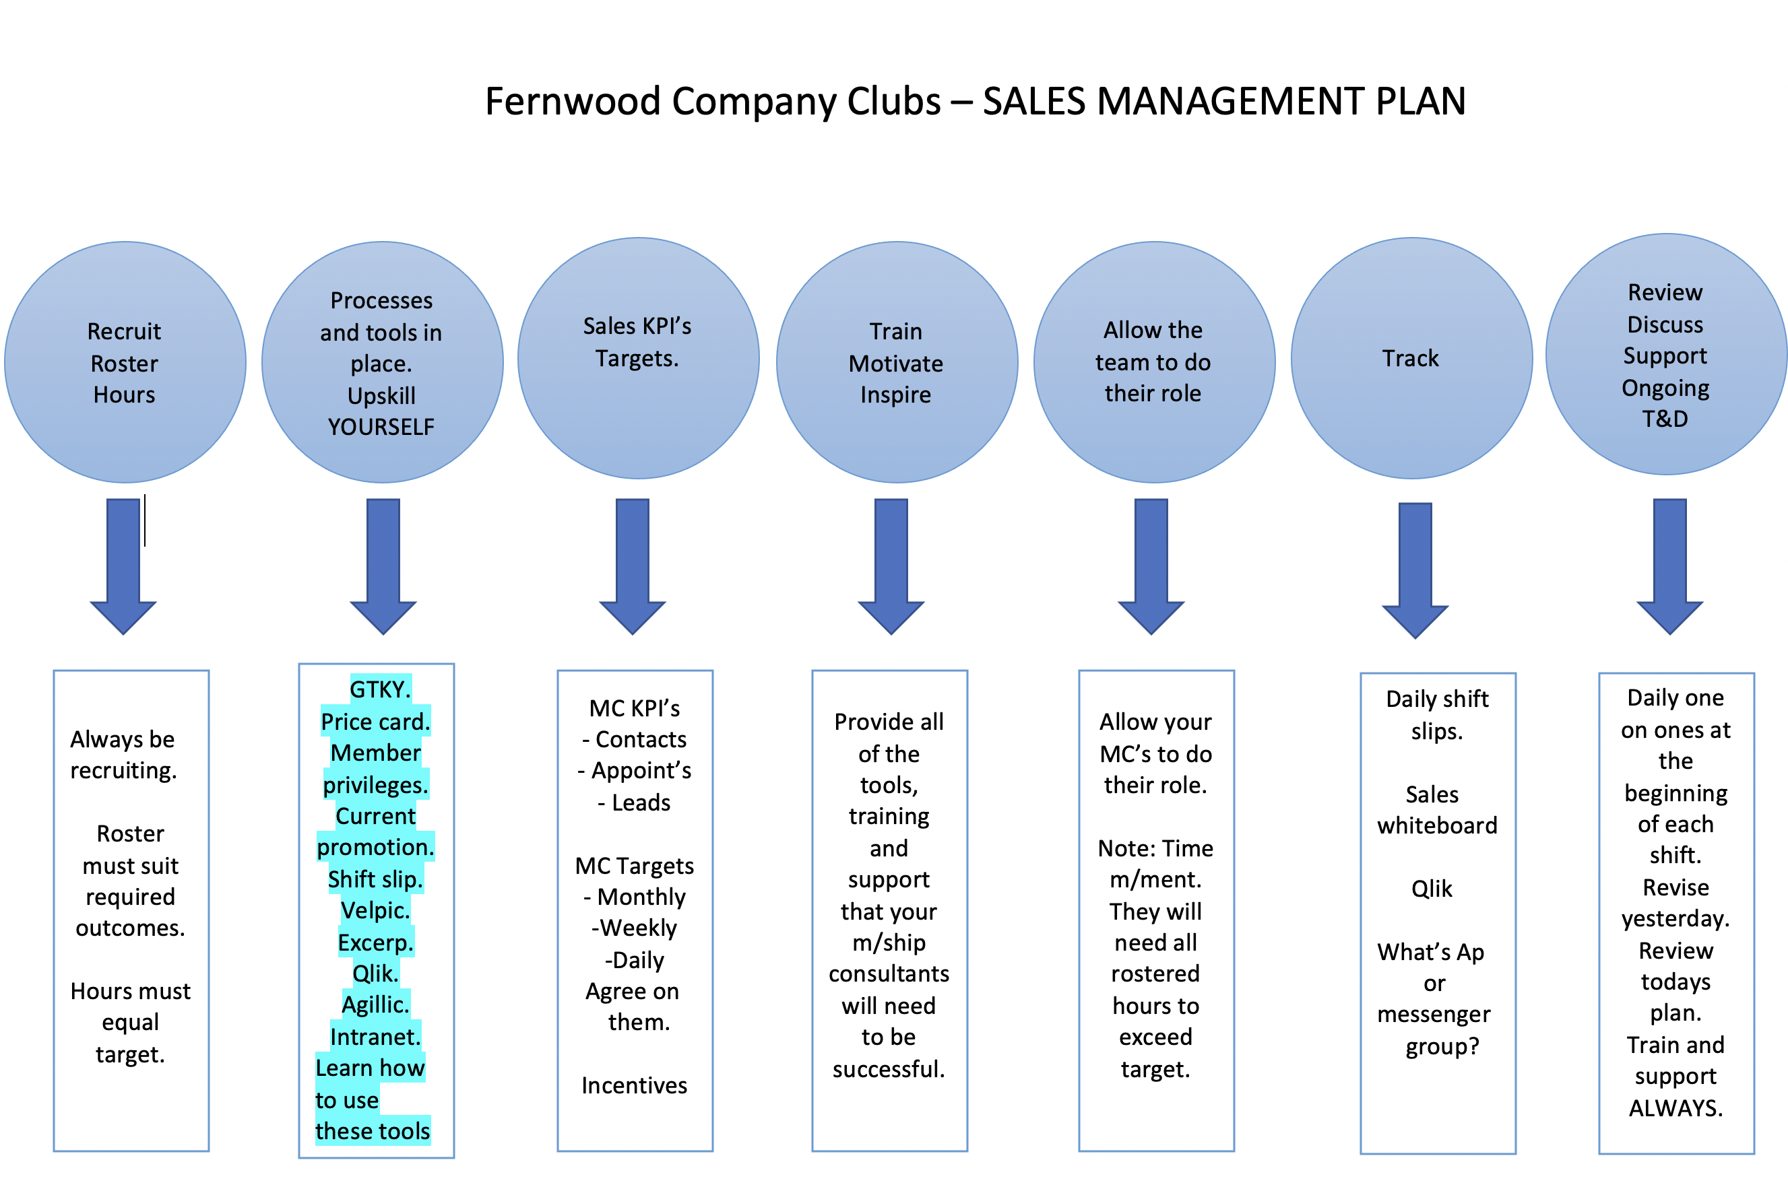
Sales management ball 2

Slide 12
Processes in place.
GTKY.
Price card.
Member privileges.
Current promotion.
Shift slip.
Velpic.
Exerp.
Qlik.
Agillic.
Intranet.
Learn how to use these tools
Marketing calendar and planning. How many leads will you need this month to hit target?

Slide 13
Are YOU across them all?
You can’t lead your team on these processes if you are not up to speed. Can you tour, close, call, book appointments, self generate leads?
Having the skill do do all of these things will enable you to train and support your team effectively.
Being able to lead generate internally and maximise every appointment and sale opportunity is more important now than ever.

Slide 14
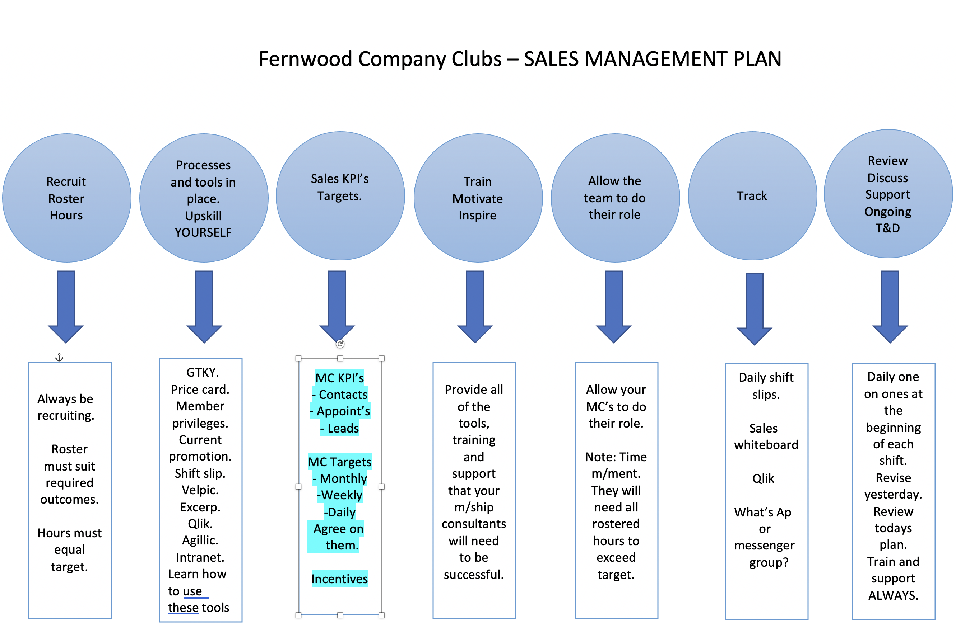
Sale management ball 3

Slide 15
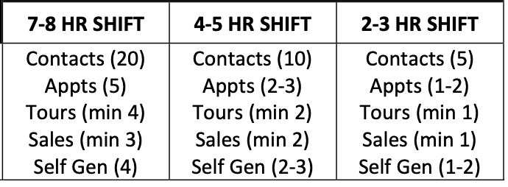
MC KPI’s

Slide 16
MC targets
Monthly
Weekly
Daily
Agree on them.
Link incentives if applicable.
Agreed targets become non negotiable.

Slide 17
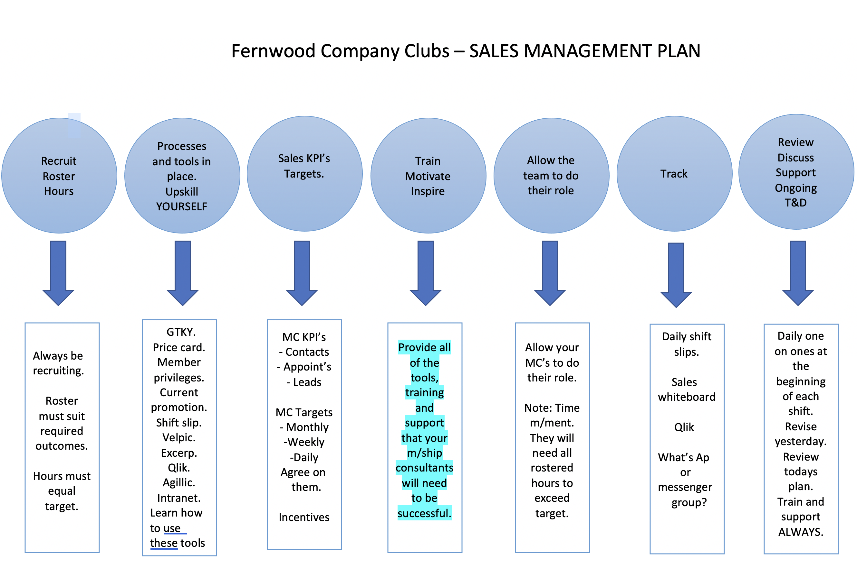
Sales management ball 4

Slide 18
Sales management ball 4
Make available all of the tools, training and support that your m/ship consultants will need to be successful.
Training and development is of course on going but getting your membership consultant off to a good start is vital.
If your membership consultants don’t get a taste of success you may find yourself recruiting again soon.

Slide 19
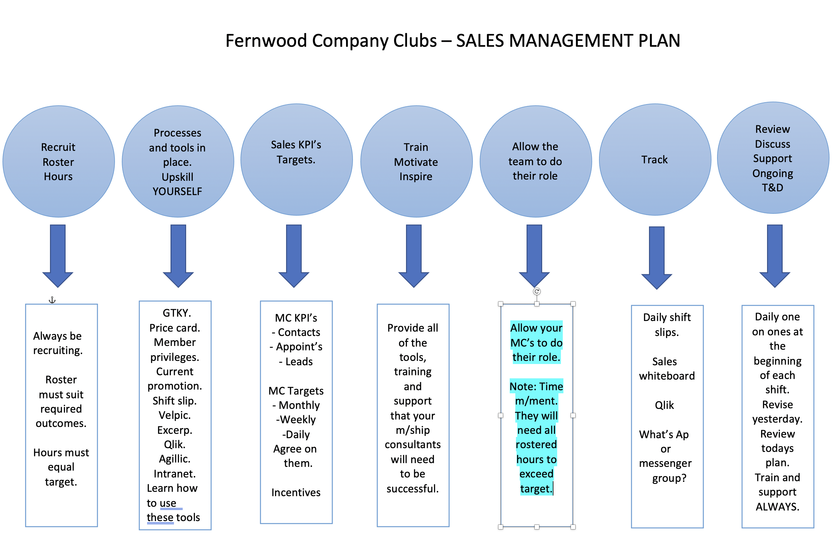
Sales management ball 5

Slide 20
Allow some freedom..
Allow your MC’s to do their job ☺
Assist them with time management as they will need all rostered hours to exceed target.

Slide 21
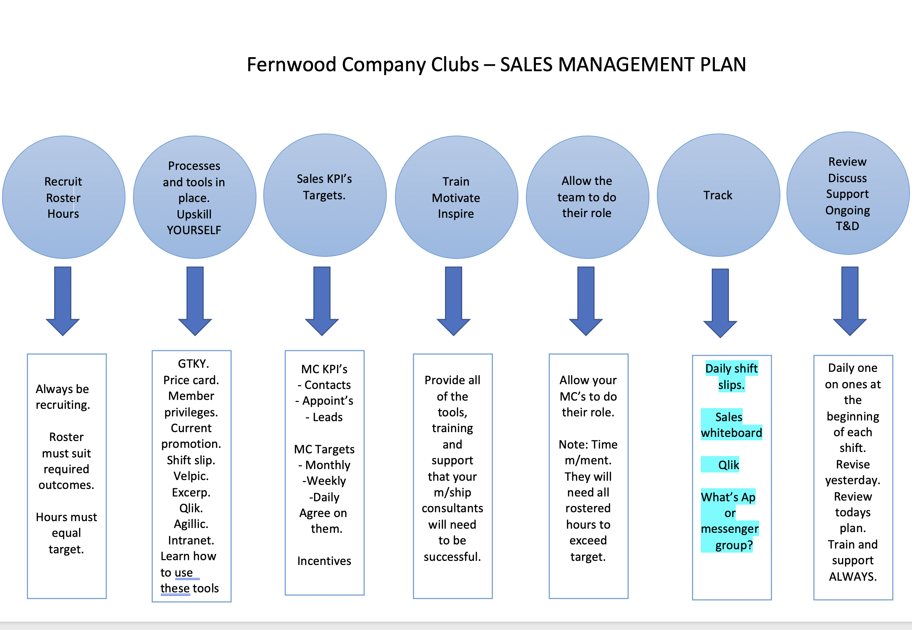
Sales management ball 6

Slide 22
Sales management ball 6 - Tracking
Daily shift slips.
Sales whiteboard
Qlik
What’s Ap or messenger group?

Slide 23
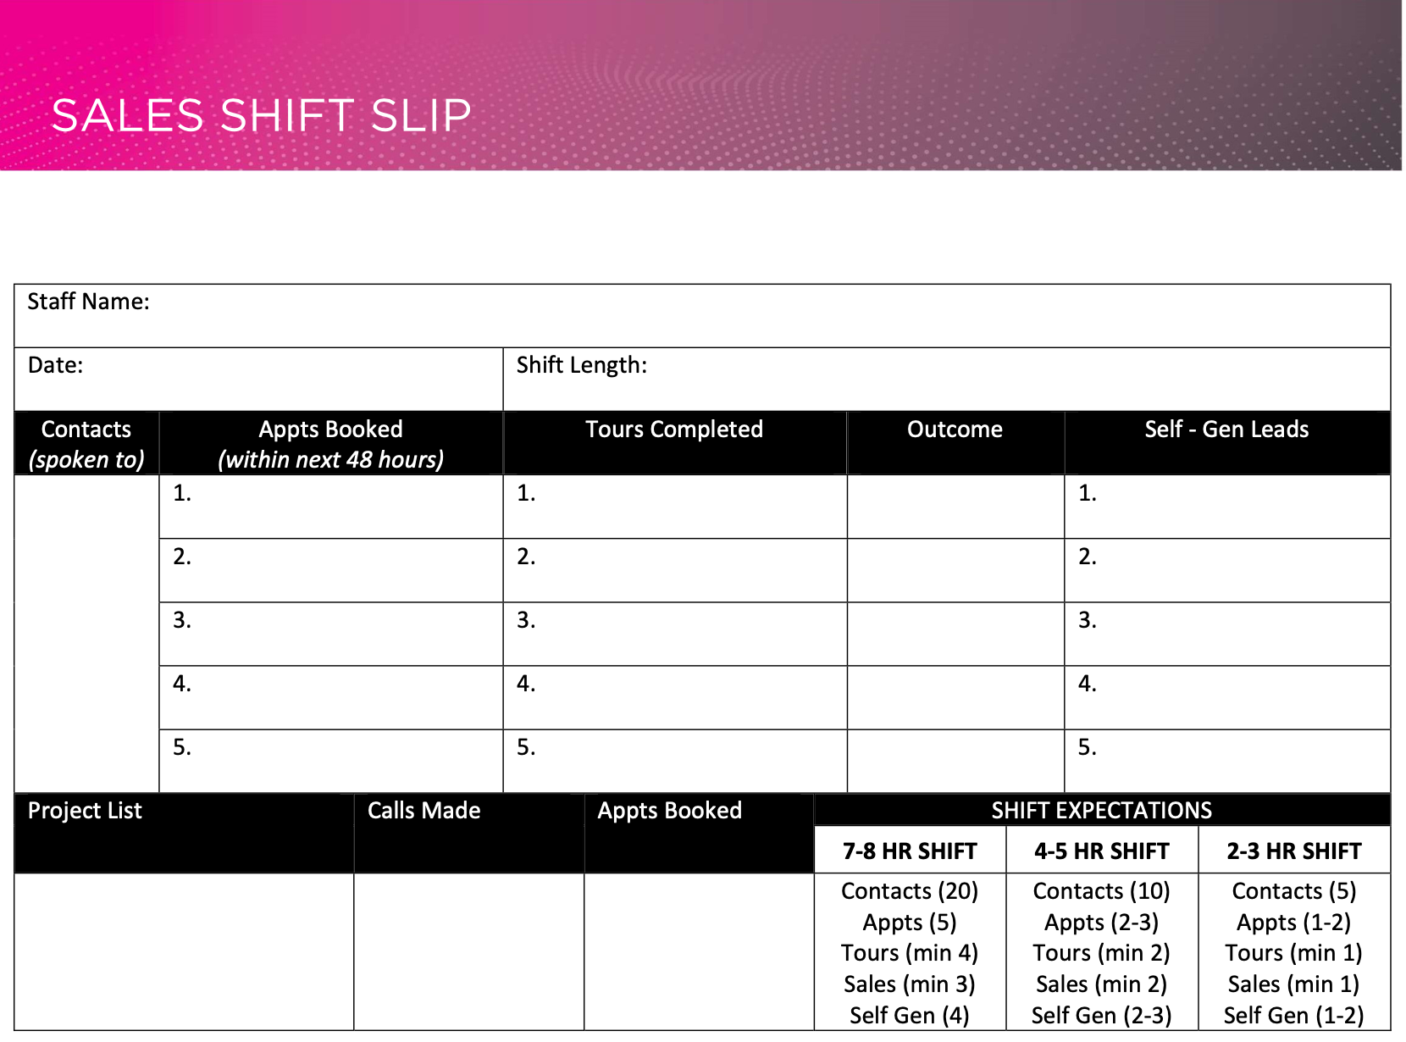
Daily shift slip

Slide 24
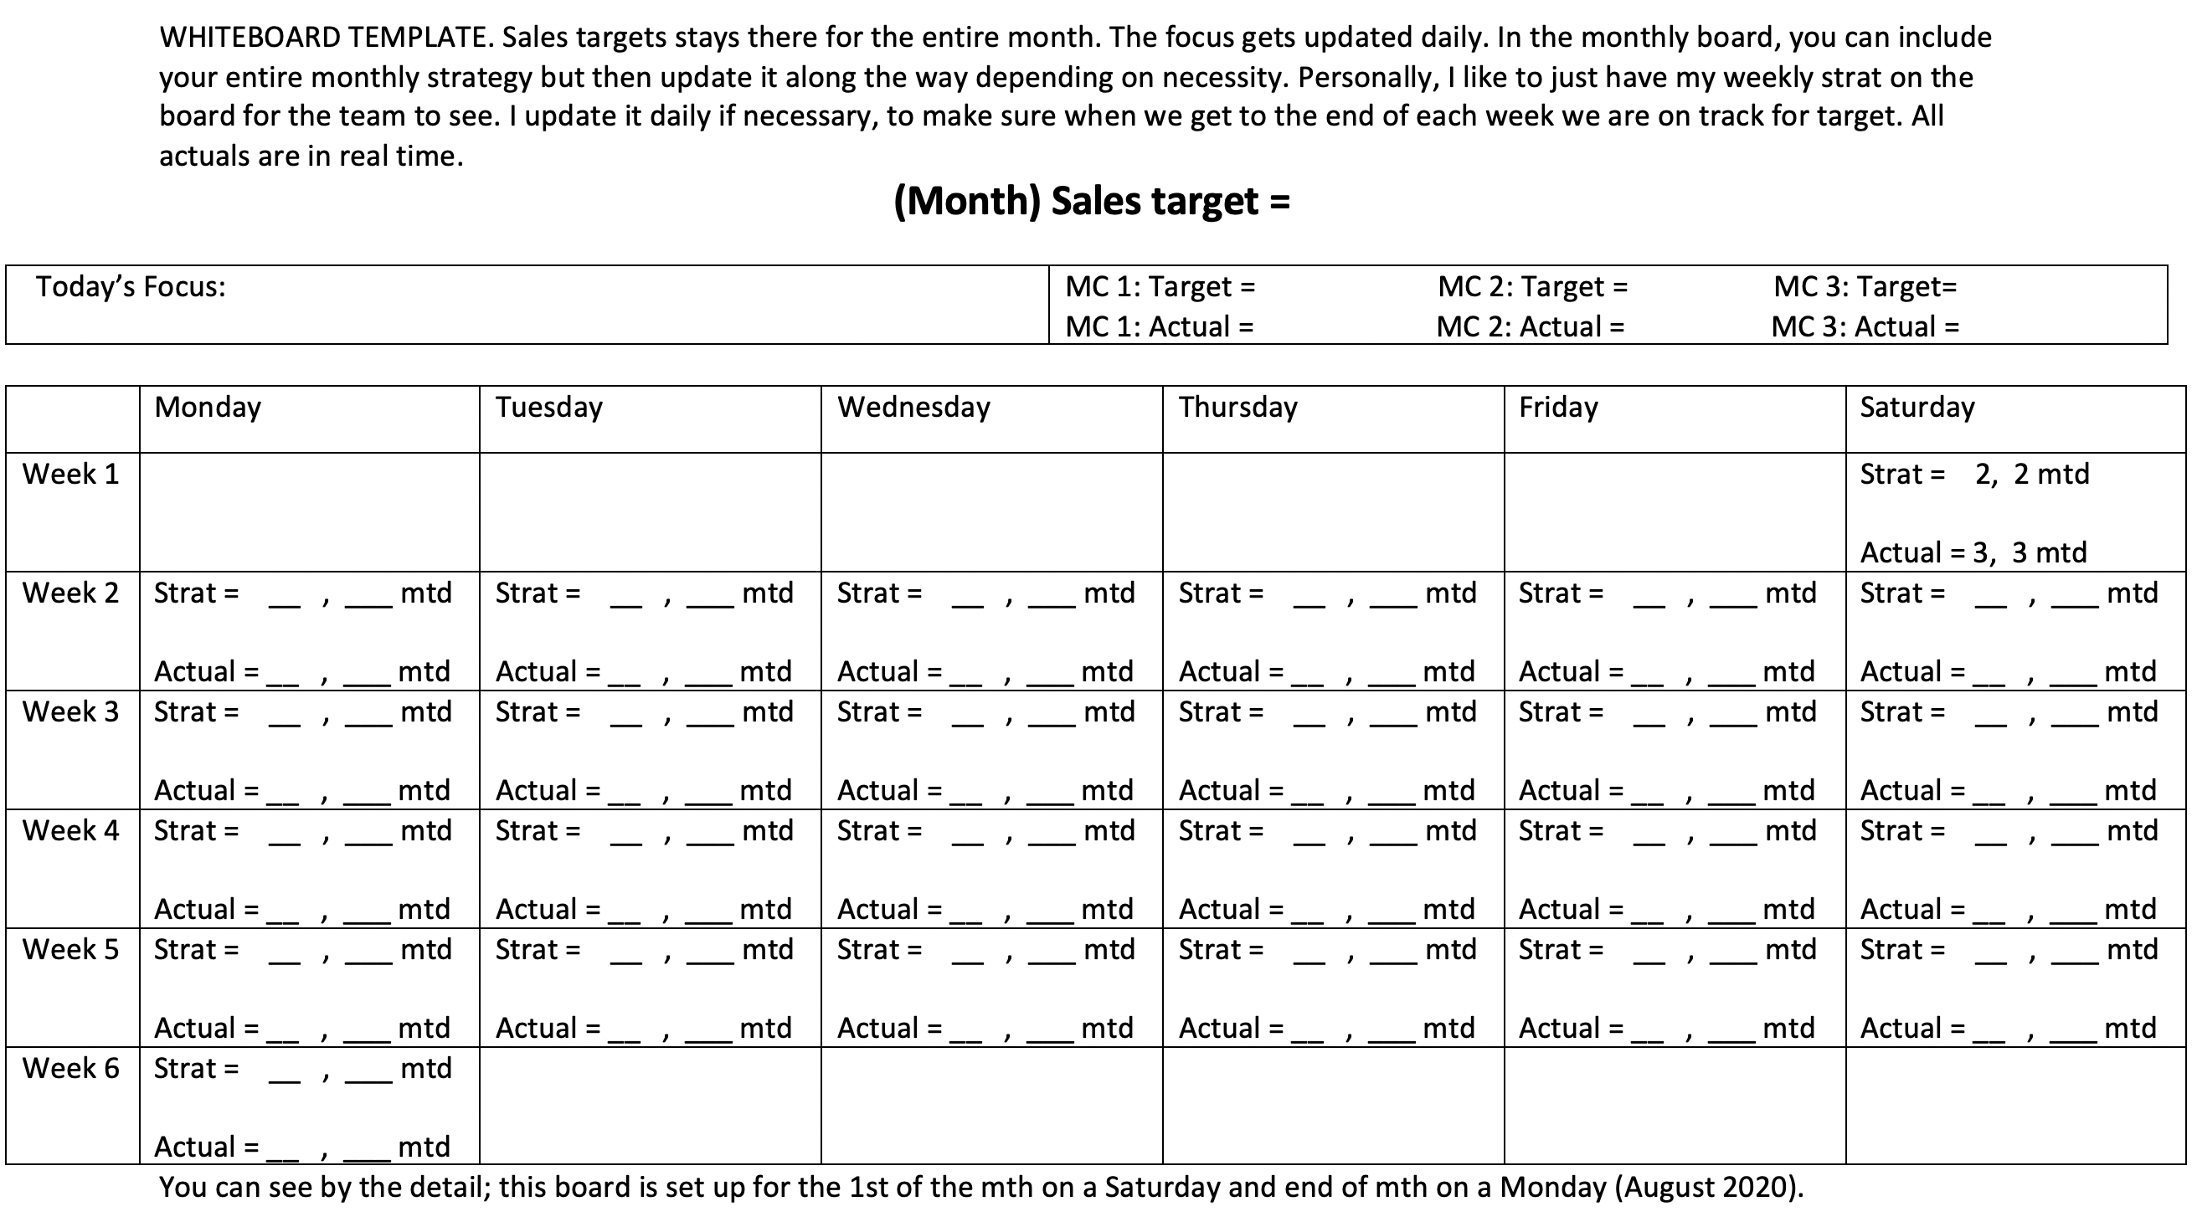
Sales whiteboard

Slide 25
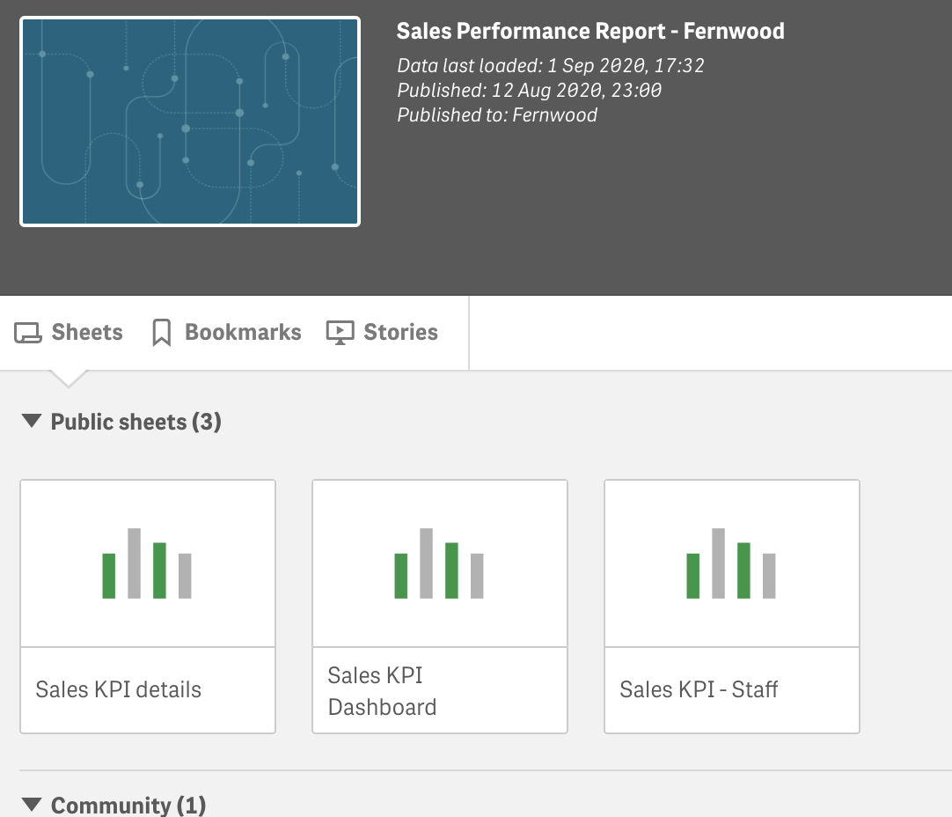
Qlik

Slide 26
Sales KPI details

Slide 27
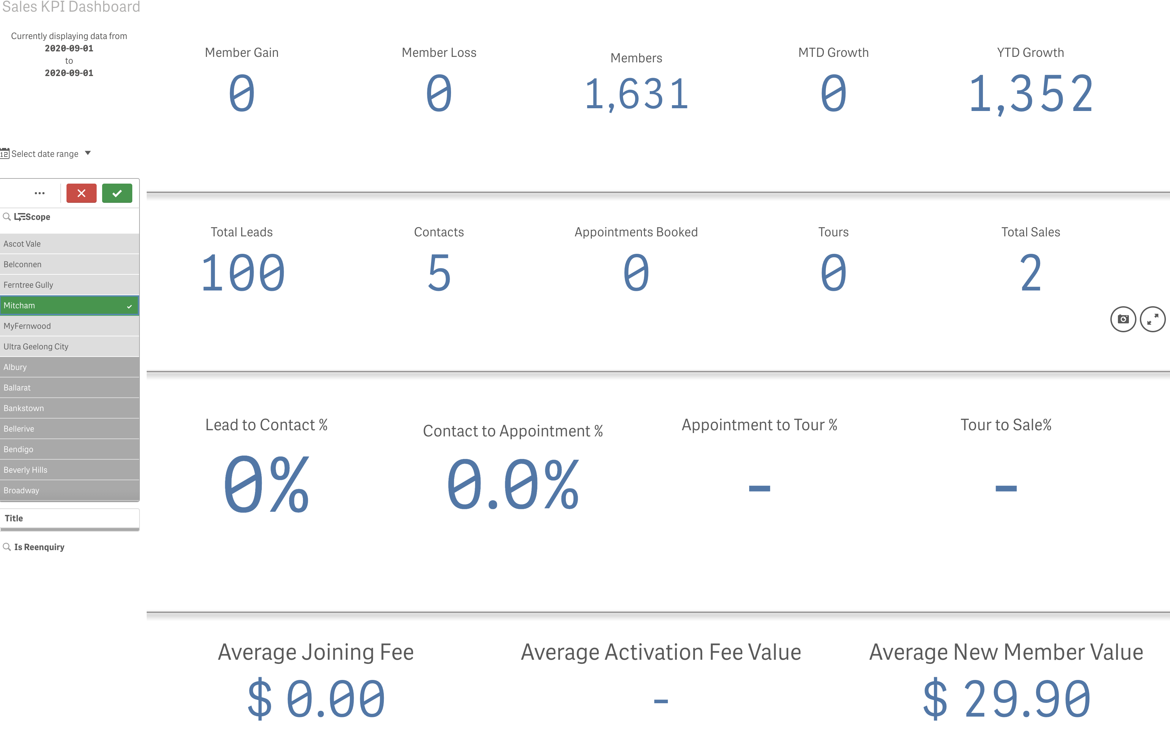
Sales KPI dashboard

Slide 28
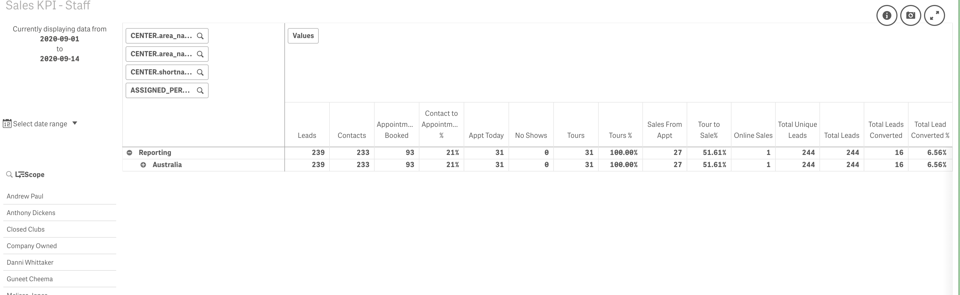
Sales KPI staff

Slide 29
What’s AP or messenger groups
Great for that final layer of accountability.
Sales specific.

Slide 30
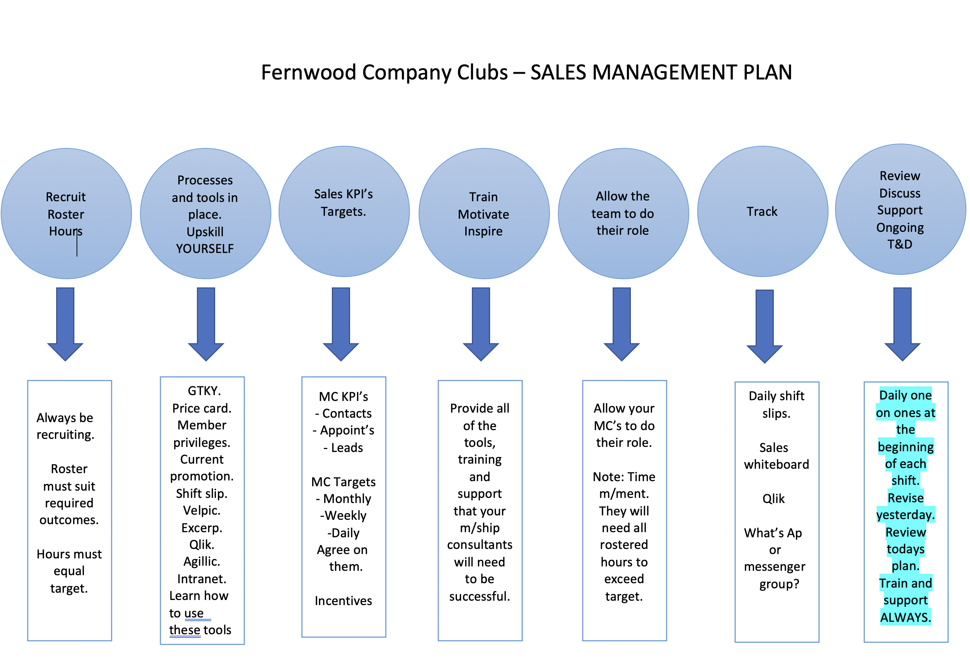
Sales management ball 7

Slide 31
Daily one on ones
Daily one on ones at the beginning of each shift.
Revise yesterday.
Review todays plan.
Train and support

Slide 32
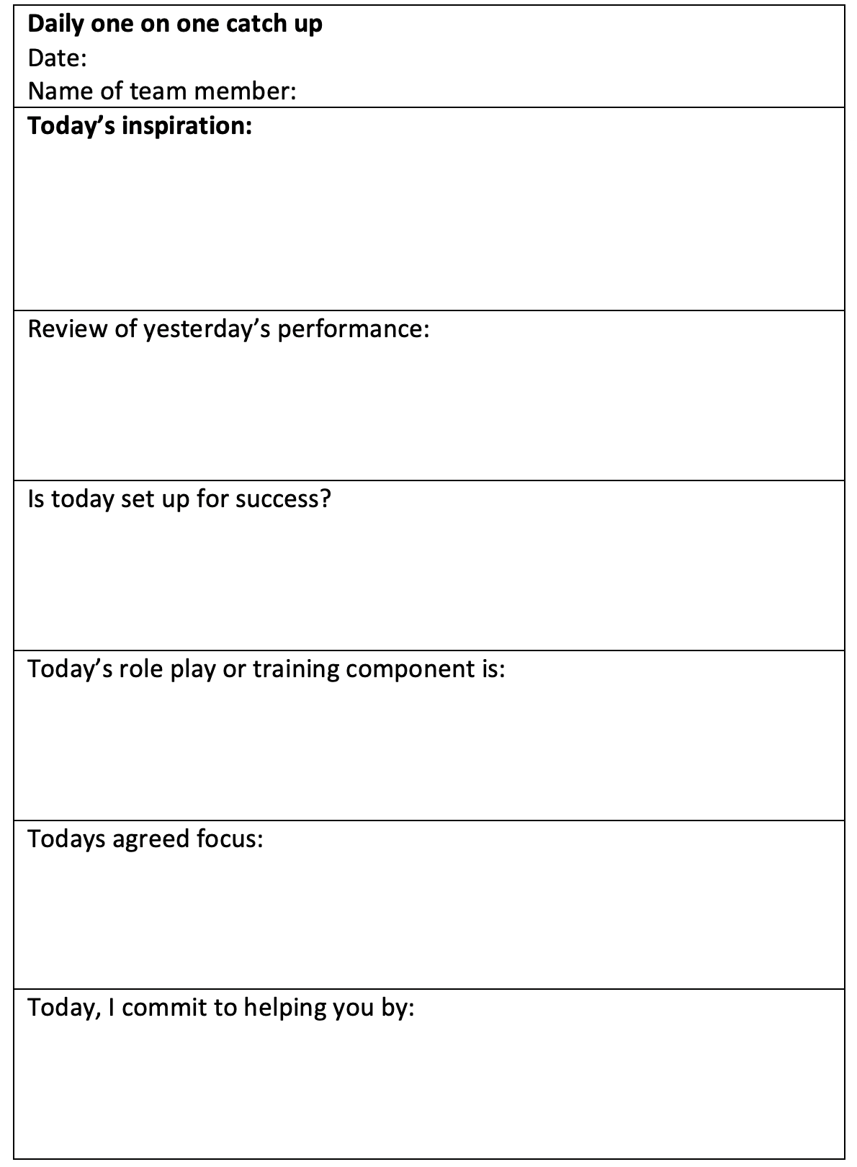
Daily one on ones

Slide 33
Training and development
ALWAYS

Slide 34
You’ll need a plan…

Slide 35
Good luck
Identify YOUR strengths and continue to improve these.
Identify YOUR challenges and implement a strategy to fill the gaps and improve.
Call me any time ☺
Belinda Amis Wheaton
0433 100 929
belinda.amis@fernwoodfitness.com.au

